Slide 1
Understanding Sepsis;
What it’s all about
Michelle Westrich RN BSN
Alverno College MSN Student
All images imported from Microsoft Clipart unless otherwise cited.

Slide 2
Tutorial Directions
Click on to go to previous slide
Click on to go to next slide
Click on to go to menu slide
Click on or hover over underlined words for more information

Slide 3
Menu
Objectives
Signs and symptoms
Vulnerable populations
Definitions
Diagnostics
Genetics
Inflammation
Treatment
Aging
Coagulation
Xigris
Stress
Impaired Fibrinolysis
Nursing roles
Case study 1 Review
Endothelial dysfunction
Case study 2 Review
Acute organ dysfunction
References

Slide 4
Objectives
Define Sepsis, Severe Sepsis and Septic Shock
Discuss the pathophysiology of severe sepsis and septic shock
Discuss the role of inflammation in sepsis
Name three signs and symptoms of sepsis
Discuss treatment of severe sepsis and septic shock
Define populations vulnerable to developing severe sepsis

Slide 5

Definitions
Systemic inflammatory response syndrome (SIRS):
A complex, widespread inflammatory response to a clinical trigger. i.e. Infection, trauma, burns, surgery, pancreatitis.
  Temperature > 38°C or < 36°C (>100.4°F or <96.8°F)
  Heart rate >90/min
  Respiratory rate >20/min or PaCO2 < 32mm HG
  WBC >12 or <4 or with 10% immature neutrophils (bands)
Multiple organ dysfunction syndrome(MODS):
The presence of altered organ function in an acutely ill patient such that homeostasis cannot be maintained without intervention.
Infection: Microorganism invasion of a normally sterile site.
  Sepsis: Refers to the body’s systemic response to an infection. An infection with the presence of more than one of the symptoms of systemic inflammatory response (SIRS).
  Severe sepsis: Sepsis with organ dysfunction, hypoperfusion or hypotension (infection + SIRS+ organ dysfunction).
Septic shock: Sepsis with hypotension despite adequate fluid resuscitation.
Bone et al., 1992

Slide 6
Why should I care about sepsis?
So, what’s the big deal about sepsis?
Sepsis has no cure and the mortality rate is unacceptably high! More than 750,000 patients develop severe sepsis annually; 30-50 % will die, we can increase that number to 60% when shock is present (International Sepsis Forum, 2003).
The CDC lists septicemia as the 10th leading cause of death in 2007 and it accounts for more deaths that colon, breast, prostate and pancreatic cancers combined. Severe sepsis is the leading cause of death in adult ICUs and hospitals spend tens of billions of dollars each year. These patients are dying in our hospitals receiving the best care we have to offer (Picard, K., O'Donoghue, S., Young-Kershaw, D., & Russell, K. 2006).
Nurses are in the position to identify patients who are risk for developing severe sepsis and for recognizing early signs and symptoms and facilitating appropriate evidenced-based care.
Notes:
According to the literature, over 750,000 patients in the US develop severe sepsis.
It was projected to reach 1 million this year. The aging population, stronger antibiotics and technology have contributed to the increase in incidence.
The mortality rate for severe sepsis is unacceptably high ranging from 30-60%, and with delay in treatment and additional organ dysfunction, mortality increases.
The CDC listed septicemia as the 10th leading cause of death in the US in 2007. Many cases of sepsis such as pneumonia are not captured by this data so the true number of deaths due to sepsis is much higher.
US hospitals spend 10s of billions of dollars each year to treat severe sepsis.
You should care about sepsis because nurses are in the position to identify patients who are at risk for developing severe sepsis and recognizing early signs and symptoms and facilitating appropriate evidence based care for these patients.
The Surviving Sepsis Campaign recommends treatment bundles for the treatment of severe sepsis and at the heart of treatment is early goal directed therapy

Slide 7
Severe Sepsis
Now that we have reviewed definitions, we can say that severe sepsis is an infection plus more than one symptom of SIRS.
It is a complex syndrome affecting nearly 1 million patients, costing tens of billions of dollars to treat and taking the lives of up to 50% of the people that develop this syndrome.
The next slide illustrates the association of mortality and organ dysfunction which emphasizes the importance of early recognition and treatment.

Slide 8
Severe sepsis mortality increases with the number of organ dysfunction
The key is to identify sepsis early and prevent progression to severe sepsis and septic shock. This graph shows that as the number of organ dysfunction increases, so does mortality, equaling about 20% mortality per organ.
Copyright ©2008 Eli Lilly and Company. Printed with permission

Slide 9


Let’s stop for a review
Which are symptoms of SIRS?
Nausea, vomiting and diarrhea
Redness, swelling, warmth and itching
Tachycardia, tachypnea, elevated WBCs and fever

Slide 10
That’s correct!
SIRS is characterized by fever/hypothermia, tachycardia, tachypnea/ decreased CO₂, and elevated/decreased WBCs with bands.
Question slide

Slide 11

No, remember the definitions. SIRS is fever/hypothermia, tachycardia, tachypnea/ decreased CO₂, and elevated/decreased WBCs with bands.
Question slide

Slide 12
Review cont.
Click on the boxes
Correct! Severe sepsis is the leading cause of death in ICUs.
True
True or False : Severe sepsis is the third leading cause of death in adult ICUs.
True or False : Hospitals spend $1 billion dollars treating severe sepsis.
True or False : Severe sepsis has about a 50% mortality rate.
False
No, Severe sepsis is the leading cause of death in ICUs.
Correct! Hospitals spend $17 billion dollars each year treating severe sepsis.
True
False
No, Hospitals spend $17 billion dollars each year treating severe sepsis.
True
False
Correct!
No, severe sepsis has about a 50% mortality rate.

Slide 13
Pathophysiology of Severe Sepsis
There are multiple pathways involved in the inflammatory processes of severe sepsis.
Normally there is a balance in these functions. The dysfunction that occurs in severe sepsis leads to widespread inflammation and blood clotting.
sepsis
Coagulation
Impaired
Fibrinolysis
Inflammation
Endothelial dysfunction

Slide 14

Pathophysiology of Severe Sepsis
Inflammation
  Normally the inflammatory process protects the body ; in severe sepsis uncontrolled systemic inflammation overwhelms the body’s normal protective mechanisms.
  In response to a pathogen, the body triggers an inflammatory reaction which normally fights off the invasion and protects the body. White blood cells (WBCs) become activated and release pro-inflammatory cytokines, TNFα and interleukins.

Slide 15
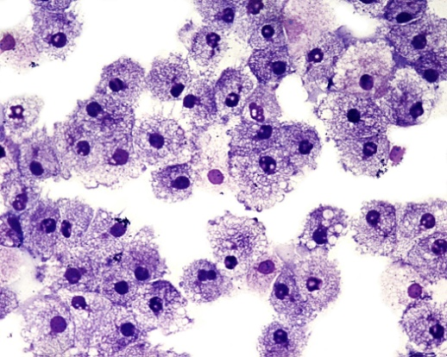
Pathophysiology of Severe Sepsis
Inflammation
The release of pro-inflammatory cytokines begins to attract other WBCs (macrophages and monocytes) and creates a cascade effect as they stimulate the production of other cytokines.
When this process gets out of control and anti-inflammatory mediators fail to regulate inflammation, we develop the systemic inflammatory response which leads to coagulation, impaired fibrinolysis and ultimately tissue hypoxia because the blood clots impair the diffusion of oxygen through the capillaries to the cells.
Eli Lilly & Company, 2008.

Slide 16
Pathophysiology of Severe Sepsis
Inflammation
Coagulation is stimulated by inflammatory mediators leading to widespread clotting in the microvasculature.
Inflammatory mediators also impair fibrinolysis reducing the body’s ability to lyse clots.
Increased clotting and decreased fibrinolysis
Hypoperfusion & Cellular Hypoxia
Tissue injury & organ dysfunction
Eli Lilly & Company, 2008.

Slide 17
Inflammation review
In severe sepsis, pro-inflammatory cytokines TNFα and interleukins stimulate inflammation and trigger coagulation.
True
or
False
Correct!
Sorry, this is true.
Bacterial Invasion
Sorry, bacterial invasion starts the process but is not the mechanism.
The mechanism that impacts patients most in severe sepsis is:
Hypoperfusion and cellular hypoxia
Correct! This process leads to tissue injury, organ dysfunction and eventually death.
Fever
No, fever is a symptom of SIRS.

Slide 18
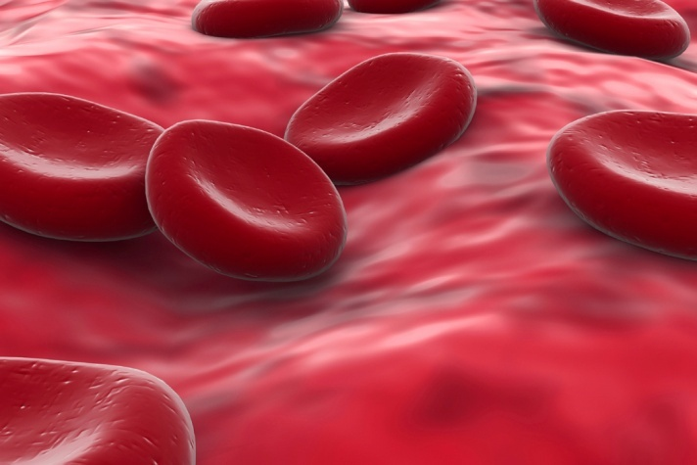
Pathophysiology of Severe Sepsis
Coagulation
  In response to an antigen and stimulation of the inflammatory response, cytokines stimulate the release of tissue factor which initiates the coagulation cascade. Blood clots are produced when thrombin converts fibrinogen to fibrin. (Ahrens, T. & Vollman, K., 2003).
As a result of widespread blood clots in the microvasculature, blood flow and tissue perfusion is reduced starving cells of oxygen and causing them to begin undergoing anaerobic metabolism creating lactic acid as a byproduct.

Slide 19
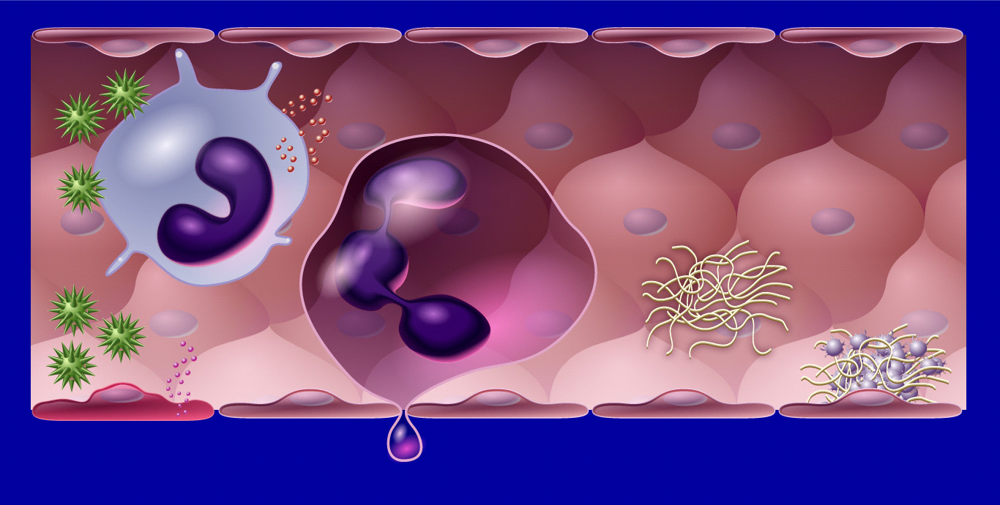
Pathophysiology of Severe Sepsis
Activation of coagulation
Tissue Factor
Coagulation
Factor VIII
Monocyte
cascade
Factor VIIIa
Organisms
Factor V
Factor Va
Thrombin
Fibrin clot
Chemoattractants
Fibrin
tissue factor
This picture illustrates the activation of the coagulation cascade. The monocyte reacts to the antigen by releasing tissue factor which begins the cascade resulting in thrombin causing fibrin to form a fibrin clot. In severe sepsis, this process is happening throughout the microvasculature causing hypoperfusion and cellular hypoxia.
Copyright ©2008 Eli Lilly and Company. Printed with permission

Slide 20
Pathophysiology of Severe Sepsis
Impaired fibrinolysis
The major dysfunction in fibrinolysis is the body’s inability to lyse clots.
Cytokines stimulate release of Plasminogen activator inhibitor-1 (PAI-1).
PAI-1 prevents release of Tissue plasminogen activator (tPA).
Ever heard of tPA? It lyses clots.
Protein C is unable to become activated (APC).
Decreased levels of APC impair fibrinolysis and enhance clotting.
Eli Lilly & Company, 2008.
Notes:
The major dysfunction in fibrinolysis is the body’s decreased ability to break down clots formed by the activation of the coagulation cascade. As a result many clots form in the microvasculature decreasing the tissues ability to extract oxygen from the capillaries thus resulting in hypoperfusion and cellular hypoxia and organ failure.
Normally clots would be broken down but Thrombin inhibits clot lysis by facilitating the release of plasmin activator inhibitor-1 (PAI-1) from endothelial cells and platelets. PAI-1 suppresses fibrinolysis by reducing the ability of tissue Plasminogen Activater (tPA) to promote clot lysis.
Protein C is a blood protein, when converted to it’s active form by thrombin has anticoagulant and antiinflammatory actions.
In severe sepsis Protein C levels are depleted, and decreased levels are associated with increased risk of death.

Slide 21
Pathophysiology of Severe Sepsis
Endothelial dysfunction
  The dysfunctional endothelium accounts for much of the pathology of sepsis, resulting in capillary leak, hypotension, microvascular thrombosis, tissue hypoxia and organ failure. (Hein et al. 2005).
The endothelium is the continuous single-cell lining of our blood vessels.
In addition to WBCs, endothelial cells become activated during invasion by an antigen and contribute to the inflammatory response.
Inflammatory mediators (cytokines TNFα and interleukins) alter the endothelial membrane resulting in increased capillary permeability. When the normally tight endothelium lining becomes more permeable, cells and fluids leak out into the extravascular space causing edema and hypotension related to decreased intravascular volume.
Upregulation of adhesion molecules attracts WBCs and cause them to stick to the endothelium.
Eli Lilly & Company, 2008.

Slide 22
Pathophysiology of Severe Sepsis
Endothelial dysfunction
Free Radicals
WBC’s release free radicals in an attempt to destroy antigens. Widespread release of free radicals causes molecular instability and bacterial cell walls disintegrate (Ahrens, T. & Vollman, K., 2003).
As a result of the previously described mechanisms, the endothelial lining becomes damaged and dysfunctional and contributes to the systemic inflammatory response, tissue hypoxia and organ dysfunction.
Nitric Oxide is released by endothelial cells resulting in loss of vasomotor tone causing vasodilatation and hypotension (Jean-Baptiste, E., 2007).
Notes:
As a result of the previously described mechanisms, the endothelial lining becomes dysfunctional and contributes to the systemic inflammatory response, tissue hypoxia and organ dysfunction.

Slide 23
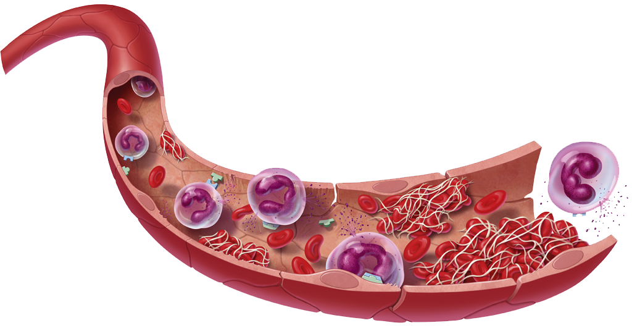
Pathophysiology of Severe Sepsis
This diagram summarizes the processes occurring during systemic inflammation. The key to improve outcomes is early identification and aggressive treatment to restore tissue oxygenation and prevent organ dysfunction.
Microvascular dysfunction
↑ Inflammation
↑ Coagulation
↓ Fibrinolysis
Organ dysfunction
Global tissue hypoxia
Direct tissue damage
→
Hypoperfusion/hypoxia
Microvascular thrombosis
Endothelial dysfunction
→
Copyright ©2008 Eli Lilly and Company. Printed with permission

Slide 24
Let’s review
When the semi-permeable membrane of the endothelium becomes more permeable, the blood vessels fill with more fluids from the extravascular space.
True
or
False
Correct! The fluids leak out of the blood vessels leading to hypotension.
Sorry. The fluids leak out of the blood vessels leading to hypotension.
tPA and activated protein C stimulate widespread clotting in the blood vessels.
True
or
False
Sorry, this is false, these factors are inhibited and lead to impaired fibrinolysis.
Correct, these factors are inhibited and lead to impaired fibrinolysis.
True
or
False
Activation of coagulation and impaired fibrinolysis lead to hypoperfusion and cellular hypoxia.
Correct! This is the basic pathophysiology mechanism in severe sepsis.
Sorry, this is true. This is the basic pathophysiology mechanism in severe sepsis.

Slide 25
Acute organ dysfunction
click on the words in the boxes
CNS:
Confusion
altered consciousness
Cardiovascular:
Tachycardia
Hypotension
Respiratory:
Tachypnea
↓ pulse oximetry
↑ oxygen needs
Renal:
Oliguria
Anuria
↑ BUN/creatinine
Hepatic:
Jaundice
↓ albumin
↑ liver enzymes
Hematologic:
↓ platelets
↑ PT/INR, aPTT
↓ protein C
↑ D-dimer
Metabolic:
Metabolic acidosis
↑ lactate
Copyright ©2008 Eli Lilly and Company. Adapted and printed with permission

Slide 26
Signs and symptoms of severe sepsis
Tachycardia (>90 bpm)
Hypotension
Respiratory distress
  Increased respiratory rate
Hypoxia
  Decreased pulse ox
Fever/hypothermia
Altered mental status
  Confusion, lethargy, anxiety, unresponsive
Decreased urine output
  Less than 0.5ml/kg/hr
Edema
Cool/mottled skin
Decreased capillary refill time
Sawyer Sommers, M. & Bolton, P., 2001.

Slide 27
Diagnostics
Elevated WBCs
  With immature bands
CXR
  Infiltrates/ARDS
C reactive protein
  Elevated in response to inflammation
ABG
  Early respiratory alkalosis
  Late respiratory/metabolic acidosis
CBC
  Thrombocytopenia
Blood Cultures
  To identify organism
Chemistry
  Elevated BUN/creatinine
  Hyperglycemia
  Elevated LFTs
  Elevated lactate
Sawyer Sommers, M. & Bolton, P., 2001.

Slide 28
Treatment
“A bundle is defined as a group of interventions related to a disease process that, when implemented together, result in better outcomes than when implemented individually.” (IHI.org, 2005) The Severe Sepsis Bundles are designed to allow teams to follow the timing, sequence, and goals of the individual elements of care, in order to achieve the goal of a 25 percent reduction in mortality from severe sepsis (Surviving Sepsis Campaign, n.d.).

Slide 29
Treatment
Sepsis Resuscitation Bundle (begin in the first six hours)
  Serum lactate
  blood cultures
  Antibiotics w/in 3 hrs
  Fluids & vasopressors
  CVP ≥8, ScvO₂ ≥ 70%
Sepsis Management Bundle
  Steroids
  Xigris
  Glucose control
  Plateau pressures < 30cm H₂O for mechanically ventilated patients
For more detailed information on sepsis bundles, the reader is encouraged to visit the following web sites:
http://www.survivingsepsis.org/Bundles/Pages/default.aspx
http://guidelines.gov/summary/summary.aspx?doc_id=12231&nbr=006316&string=sepsis
http://www.ihi.org/IHI/Topics/CriticalCare/Sepsis/
Dellinger, R. et al., 2008.

Slide 30
Time for review
Tachycardia, hypotension and tachypnea are all symptoms that may be present in the patient with severe sepsis.
True
or
False
Correct! These are sometimes the first symptoms that may alert us to severe sepsis.
Sorry. These are sometimes the first symptoms that may alert us to severe sepsis.
True
or
False
Respiratory acidosis occurs when the patient hyperventilates.
Sorry, this is false. Respiratory acidosis occurs from elevated CO₂ , hyperventilation will result in alkalosis
Correct! The patient will develop respiratory alkalosis when they hyperventilate.
True
or
False
In the Sepsis resuscitation bundle, patients should receive Xigris.
Sorry. Not every patient should receive Xigris. They must meet specific criteria.
Correct! Patients must be carefully screened for this treatment.

Slide 31

Xigris (Drotrecogin alfa activated)
According to the Sepsis Bundles, every patient diagnosed with severe sepsis should be evaluated for treatment with Xigris.
Xigris is human recombinant activated protein C (rhAPC). It was approved by the FDA in 2001 for the treatment of patients with severe sepsis and a high risk of death as classified by failure of more than one organ and an APACHE II score of >25.
“It is the only sepsis-specific medication proven to have a mortality benefit” (Martin, J., & Wheeler, A., 2009, p. 9). Because protein C levels are depleted in sepsis, (see earlier slide) treating with recombinant activated protein C helps the body fight the effects of sepsis by providing the anti-inflammatory, anti-thrombotic and pro-fibrinolytic functions of APC. “…we are restoring a naturally occurring protective protein that allows a return toward homeostasis…” (Ahrens, T. & Vollman, K., 2003, p. 10).

Slide 32
Xigris (Drotrecogin alfa activated)
Studies
The initial research into the effectiveness of Xigris was tested in the PROWESS trial (Protein C, World-wide Evaluation of Severe Sepsis) which reported its results in 2001. The findings supported the use of Xigris in patients with severe sepsis and a high risk of death with a mortality reduction of 6% in the treatment group (Martin, J., & Wheeler, A., 2009).
The ENHANCE trial (Extended Evaluation of Recombinant Human Activated Protein C, United States) reported in 2004 that when used early in the treatment of severe sepsis, Xigris improved outcomes (higher survival rates, less days on ventilator and earlier discharge from ICU) and cost effectiveness was shown to be significant (Bernard, G., et al. 2004).
The ADDRESS trial (Administration of Drotrecogin Alfa [activated] in Early Stage Severe Sepsis) published findings in 2004 that found treatment with Xigris was not effective in patients with severe sepsis and low risk of death, supporting the use only in patients with a high risk of death (Abraham, E., et al. 2005).
Finally, in 2009 the PROGRESS registry, a large, worldwide severe sepsis registry, summarized it’s findings by reporting that patients treated with Xigris showed a significant reduction in risk of death (Martin, G. et al. 2009).

Slide 33
Xigris (Drotrecogin alfa activated)
Severe Sepsis + High risk of death (APACHE II >25 + more than one organ dysfunction).
Evaluate for treatment with Xigris.
The major side effect of Xigris has been bleeding. Having anti-thrombotic and pro-fibrinolytic properties this is not surprising, however patients must be evaluated for risk of bleeding before treatment. In addition, risk of bleeding should be compared to risk of death from severe sepsis through a careful risk-benefit consideration.
Conditions that are contraindications to Xigris therapy include:
Active internal bleeding, recent hemorrhagic stroke, recent brain/spinal surgery, trauma and brain cancer (Ahrens, T., & Vollman, K., 2003).
While Xigris has been shown to reduce mortality from severe sepsis, each patient must be carefully evaluated for appropriateness of treatment.

Slide 34

Nursing Roles
Nurses play a vital role in the ability to reduce mortality and improve patient outcomes. The first priority should be prevention of infection, followed by identification of vulnerable patients and keen physical assessment skills to detect early signs of severe sepsis.
Prevent nosocomial infections
Identification of vulnerable patients
Astute clinical assessment
Enforce infection control measures
Handwashing
Universal precautions
Oral care
Turning and skin care
Invasive catheter care (Central line bundles)
Wound care
Ely, E., Kleinpell, R., & Goyette, R., 2003.
Notes:
One of the most important factors in reducing mortality is preventing infection.
Many fundamental elements of nursing, including maintaining universal precautions, enforcing infection control measures, and vigilantly monitoring changes in physical
assessment parameters, can prevent and/or reduce the risk of infection and development of sepsis in hospitalized patients. Additionally, nursing interventions
such as turning and positioning; providing skin, catheter, and oral care; and advocating appropriate handwashing measures can help reduce the occurrence of
infection, especially the transmission of nosocomial infections.
Remember the rise of Gram Positive in hospitalized pts, think about your central line care.

Slide 35
Vulnerable populations
  Extremes of age, presence of chronic illness and immunosuppresion put people at risk for developing severe sepsis. Severe sepsis is more common among people with diabetes and cancer; surgical and trauma patients have increased vulnerability as well(Martin, J. & Wheeler, A. 2009).
Hospitalized/institutional persons
Causative organism
  Gram negative bacteria are the most common and are associated with worse mortality (Sawyer Sommers, M. & Bolton, P., 2001.).
Genetic predisposition
  Polymorphisms of inflammatory and immune genes are linked to altered responses to infection and increased risk to development of and increased mortality of severe sepsis (Jean-Baptiste, E., 2007).
Notes:
Of course we know that the very young and old are predisposed to infections and their sequele. The immunosupressed are at risk due to their weakened immune system and inability to mount an appropriate response to invading organisms. Gram negative bacteria are the cause of the majority of severe sepsis cases. The bacterial cell wall is responsible for triggering the systemic inflammatory response, but sepsis can be caused by other bacteria, fungi, yeast and parasites. Some people have genetic differences in their DNA that puts them at risk for developing severe sepsis and suffering worse mortality.

Slide 36
Let’s review
Which of the following are a contraindication for the use of Xigris?
Recent heart attack
No, Bleeding is a contraindication.
Active GI bleeding
Right! Bleeding is a side effect of Xigris, so active bleeding is a contraindication
Age > 65
No, bleeding is a contraindication.
Nurses play a very important role in reducing the incidence of severe sepsis and improving mortality .
True
Right! Nurses play a vital role.
False
Wrong. Review the nursing roles slide for examples.
True
or
False
The PROWESS trial showed a reduction in mortality of 15%.
No, the PROWESS trial showed a 6% reduction in mortality.
Correct! The PROWESS trial showed a 6% reduction in mortality.

Slide 37
Genetics in sepsis
The fact that there is great variance in individuals’ responses to infection lends support to the role of genetics in disease. In fact , De Maio, A., Torres, M., & Reeves, R.,(2005) state, “We have proposed that the clinical outcome from injury is a combination of several factors including the initiating insult, the environment, and the genetic makeup of the subject” (p.12).

Slide 38
Genetics in Sepsis
Normally our bodies are able to sense harmful organisms and through the innate immune response, isolate and destroy pathogens. This process must be regulated in order to prevent harm to the host. In severe sepsis, there is dysregulation and imbalance in the immune response. Alterations in the genes that control immune response may be to blame (Albiger, B., Dahlberg, S., Henriques-Normark, B., & Normark, S., 2007).
Studies are ongoing into genetic variations in genes responsible for inflammation and coagulation. Links are being found that predispose individuals to infection as well as severity of response to infection and mortality.

Slide 39
Genetics in sepsis
Some examples of genetic polymorphisms under investigation include TLRs, and cytokines such as TNFα and interleukins. Alterations in these genes can determine the concentrations of cytokines produced during inflammation, altering the response to infection (Arcaroli, J., Fessler, M., & Abraham, E., 2005).
Future trials and testing may lead to patient-specific treatments based on an individual’s genetic background. This would mean individualized, targeted treatment for sepsis as well as other diseases which hold the hope for improved outcomes (Arcaroli, J., Fessler, M., & Abraham, E., 2005).

Slide 40
The role of aging in sepsis
The aged are at increased risk for developing severe sepsis and have an increased mortality.
Advanced age is a known risk factor for the development of severe sepsis and increased mortality (Starr, M., Evers, M., & Saito, H., 2009).
Multiple theories exist including the presence of existing age related degenerative diseases, decreased immune response, increased release of cytokines, age related chronic inflammation, and chronic stress seen in the aged (De Maio, A., Torres, M., & Reeves, R., 2005).

Slide 41
Stress response in sepsis
Homeostasis is the body’s goal at all costs.
When homeostasis is threatened, the body initiates regulatory processes termed the Stress Response.
There are multiple triggers of the stress response. Normally the stress response protects us and is a limited process, turning off when we don’t need it any more.
During acute stress, the sympathetic nervous system is activated and begins the flight or fight response.
Septic patients are “stressed”
Kunert, M., 2005.

Slide 42
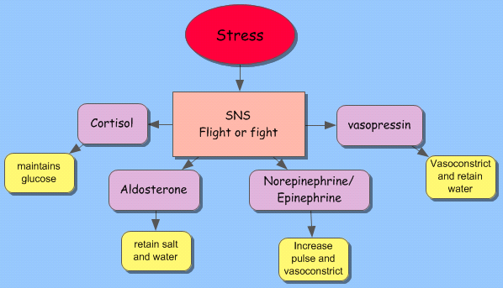
Stress response in sepsis
Created using Inspiration 9.0 by M. Westrich 2010
Because cortisol is released in response to stress, sometimes septic patients develop adrenal insufficiency from over secretion of cortisol; these patients have a higher mortality (Jean-Baptiste, E., 2007). Low dose steroid replacement may reduce mortality.
Additionally, the action of cortisol increases blood glucose which impairs the ability of WBCs to kill bacteria.
Chronic activation of the stress response leads to many health alterations including cardiovascular and immune diseases. Chronic stress puts patients at increased risk for developing severe sepsis and increases mortality.
Kunert, M., 2005.

Slide 43
Hold on a minute…
Genetic alterations in cytokine genes can cause increased susceptibility to severe sepsis and increased mortality?
True
That’s right!
False
No, genetics can increase incidence and mortality
Stress contributes to all but the following?
Adrenal insufficiency
Hyperglycemia
Increased lactate
Sorry, this is a result of the stress response.
Sorry, this is a result of the stress response.
Correct, this is a finding in sepsis, but not a result of the stress response.

Slide 44
Case study 1
A 42 y/o man presents to the ED with warmth, tenderness, redness and swelling to his right thigh. He has been taking care of it himself for two days and comes in because of increased pain and swelling to the area. His wife states that he has had a fever and has been acting “funny” since last night.
BP 84/62
Pulse 116
RR 32
SpO2 85% on room air
Temp 102° F

Slide 45

Case study 1 cont.
Does this patient have severe sepsis?
Yes
No

Slide 46
Case study 1 cont
Yes. He has an infection in his leg which is worsening. Fever, tachycardia, tachypnea, hypoxia, hypotension and confusion.
This patient has septic shock (infection plus more than one s/sx of SIRS plus hypotension.
He has increased risk of death related to his multiple organ dysfunction (neurologic, cardiovascular, respiratory.)

Slide 47

Case study 1 cont.
Incorrect, try again.
Remember the definition and symptoms of severe sepsis

Slide 48
Case study 1 cont. Treatment
What treatments will this patient receive?
Volume- Replace lost fluids
Vasopressors- goal of MAP >65
Labs: cultures, ABG, lactate, CBC, CMP, LFT, CRP
Antibiotics
O₂- may require intubation
Surgery- remove infected tissue
Corticosteroids/glucose control prn
ICU!
This patient has more than a 60% mortality risk based on the diagnosis of septic shock and the number of organs failing!

Slide 49
Case study 2
80 y/o female admitted to medical unit from a nursing home with pneumonia. Cultures were obtained and she was started on IV antibiotics. On her second day her urine output is 25ml/hr. Her BP is 85/40 (admit baseline 108/62). On her last vital sign check the CNA told the nurse that her O2 sat was 87% on room air (baseline was 94%). Her family thinks that she must not be sleeping well in the hospital because she is unusually restless and forgetful today.

Slide 50
Case study 2 cont.
These findings might seem a little subtle, but they are worrisome all the same.
Click for signs of increased vulnerability
Age
Resides in a nursing home
Chronic stress
Pre-existing illnesses
Click for changes in assessment findings
Decreasing BP
Decreasing 0₂ saturation
Decreasing urine output
Restlessness and forgetful
Click for summary
She has an infection plus she is showing signs of organ dysfunction. She should be carefully monitored and assessed for severe sepsis

Slide 51
Congratulations!

Slide 52
References
Abraham, E., Laterre, P., Garg, R., Levy, H., Talwar, D., Trzaskoma, B., et al. (2005). Drotrecogin alfa (activated) for adults with severe sepsis and a low risk of death. New England Journal of Medicine, 353(13), 1332.
Ahrens, T., & Vollman, K. (2003). Severe sepsis management: are we doing enough? Critical Care Nurse, 23(5), 2-17.
Albiger, B., Dahlberg, S., Henriques-Normark, B., & Normark, S. (2007). Role of the innate immune system in host defense against bacterial infections: focus on toll-like receptors. Journal of Internal Medicine, 261, 511-528.
Arcaroli, J., Fessler, M., & Abraham, E. (2005). Genetic polymorphisms and sepsis. Shock, 24(4), 300-312.
Bernard, G., Margolis, B., Shanies, H., Ely, E., Wheeler, A., Levy, H., et al. (2004). Extended Evaluation of Recombinant Human Activated Protein C United States Trial (ENHANCE US): a single-arm, phase 3B, multicenter study of drotrecogin alfa (activated) in severe sepsis. CHEST, 125(6), 2206-2216.
Bone, R. C., Balk, R. A., Cerra, F. B., Dellinger, R. P., Fein, A. M., Knaus, W. A., et al. (1992). Definitions for sepsis and organ failure and guidelines for the innovative use of therapies in sepsis. Chest 101(6), 1644-1655.
Dellinger, R., Levy, M., Carlet, J., Bion, J., Parker, M., Jaeschke, R., et al. (2008). Surviving Sepsis Campaign: international guidelines for management of severe sepsis and septic shock: 2008. Intensive Care Medicine, 34(1), 17-60.
De Maio, A., Torres, M., & Reeves, R. (2005). Genetic determinants influencing the response to injury, inflammation and sepsis. Shock, 23, (1), 11-17.

Slide 53
References
Eli Lilly & Company. (2008). Pathophysiology of severe sepsis. Retrieved April 7, 2010 from: https://www.lillymedical.com/lmprod/servlet/com.heartbeat.slideengine.admin.controller.AdminController_New
Ely, E., Kleinpell, R., & Goyette, R. (2003). Advances in the understanding of clinical manifestations and therapy of severe sepsis: an update for critical care nurses. American Journal of Critical Care, 12(2), 120-135.
Hein, O., Misterek, K., Tessmann, J., Van Dossow, V., Krimphove, M., & Spies, C. (2005). Time course of endothelial damage in septic shock: prediction of outcome. Critical Care, 9(4), 323-330.
IHI.org, Severe sepsis bundles.(2005). Retrieved April 4, 2010 from: http://www.ihi.org/IHI/Topics/CriticalCare/Sepsis/Tools/SevereSepsisBundle.htm
International Sepsis Forum. (2003). Promoting a better understanding of sepsis. Retrieved March 22, 2010 from: http://sepsisforum.org/PDF%20Files/2003%20revsion%20Sepsis1103.pdf
Jean-Baptiste, E. (2007). Cellular mechanisms in sepsis. Journal of Intensive Care Medicine, 22(2), 63-72.
Kunert, M. (2005). Stress and adaption. In C. M. Porth (Ed.), Pathophysiology; Concepts of altered health states (7th ed., pp.187-200). Philadelphia: Lippincott Williams & Wilkins.
Martin, G., Brunkhorst, F., Janes, J., Reinhart, K., Sundin, D., Garnett, K., et al. (2009). The international PROGRESS registry of patients with severe sepsis: drotrecogin alfa (activated) use and patient outcomes. Critical Care, 13(3), R103.
Martin, J. & Wheeler, A. (2009). Approach to the patient with sepsis. Clinics in Chest Medicine, 30(1), 1-16.

Slide 54
References
National Guideline Clearinghouse. (2010). Surviving sepsis campaign: international guidelines
for management of severe sepsis and septic shock: 2008. Retrieved April 16, 2010 from: http://guidelines.gov/summary/summary.aspx?doc_id=12231&nbr=006316&string=sepsis
Picard, K., O'Donoghue, S., Young-Kershaw, D., & Russell, K. (2006). Development and implementation of a multidisciplinary sepsis protocol. Critical Care Nurse, 26(3), 43-54.
Sawyer Sommers, M. & Bolton, P. (2001). Systemic inflammatory response syndrome and septic shock. In J. G. Alspach (Ed.). (2006). Core Curriculum for Critical Care Nursing (6th ed.). (pp. 753-770). St. Louis, Missouri: Saunders Elsevier.
Starr, M., Evers, B., & Saito, H. (2009). Age-Associated Increase in Cytokine Production During Systemic Inflammation: Adipose Tissue as a Major Source of IL-6. The Journals of Gerontology: Series A Biological sciences and medical sciences, 64A(7), 723-730.
Surviving Sepsis Campaign. (n.d.). Severe sepsis bundles. Retrieved April 4, 2010 from: http://www.survivingsepsis.org/Bundles/Pages/default.aspx
Surviving Sepsis Campaign. (2007). Sepsis: what you should know. Retrieved April 4, 2010 from: http://ssc.sccm.org/sepsis/what_you_should_know

